Slide 1

[Samsung PRISM] Preliminary Discussion
AI ML Dataset creation and classification of unit Test cases
Team
College Professor(s):
1. Dr. Anusuya K V / kva.ece@psgtech.ac.in
2. Dr. S Suriya / ss.cse@psgtech.ac.in
Students:
Bhavani A / 21Z303 / 21z303@psgtech.ac.in / bhavania2003@gmail.com
Prathibha G / 21Z332 / 21z332@psgtech.ac.in
Shrinidhi S / 21Z352 / 21z352@psgtech.ac.in / shri06math@gmail.com
Supriya K / 21z360 / 21z360@psgtech.ac.in / supriyakanagasundaram@gmail.com
Department: BE Computer Science and Engineering
Date: 16 Oct 2023

Slide 2




AI, ML | Dataset creation and classification of Unit test cases
Problem Statement
Whenever developer writes a code we need to check the code covers all the necessary cases and don’t crashes on production, so to avoid these issues tester writes test cases to check the quality of code before deploying it on production.
Test cases specially Negative test cases are very important to avoid any crashes or serious bug in code.
Objective of this work let is to create the dataset of Positive and Negative test cases(Python) and Automate the process of classifying test cases into Positive or Negative Using AI.
Team would be required to create dataset from open source and build AI Algorithm to classify the test cases into Positive or Negative.
Work-let expected duration – 6 months
3-5
Members
Expectations
Create dataset for Python Language which should consist :
function code,
corresponding test case and
class of test case (Positive or Negative)
Augment the dataset to increase the dataset and balance positive and negative class count
Verification and Validation of dataset classes
Find and Train Suitable Language model/Custom Generative model (BERT/GPT family LLMs) for classification task
Tune the hyper-parameters to get Accuracy>60% and F1 Score>50%
Training/ Pre-requisites
Hands-on Python
Knowledge of writing test cases for python function
Knowledge of Deep Learning
Knowledge of NLP and Large Language models
Objective
Input Data
(Function : Test Case)
Language Model
Output
(Test case is Positive or Negative)
Additional Documentation:
https://brightsec.com/blog/unit-testing/
https://www.geeksforgeeks.org/positive-vs-negative-vs-destructive-test-cases/
https://www.softwaretestinghelp.com/positive-and-negative-test-scenarios/
https://arxiv.org/pdf/1910.03474.pdf
“Text Classification via Large Language Models” - https://arxiv.org/pdf/2305.08377.pdf
Kick Off < 1st Month >
Understanding of Function code writing and corresponding Test case classes
Understand the NLP Basics like Text Embedding, Tokens, vocabulary, Encode-Decoder, Transformer
Milestone 1 < 2nd Month >
Open source dataset preparation – Find any open source dataset , Data scraping
Create dataset from Open source Language model like ChatGPT, BARD or LLaMA etc.
Automating the labelling of test cases
Milestone 2 < 4th Month >
Verification and validation of Dataset classes
Split The Dataset into Train, Validation and Test set keeping class balanced
Develop ML pipeline for text (Function + Test case) classification using Language model like BERT/GPT
Closure < 6th Month >
Iterative Tuning of hyper parameters and
Iterative testing the models and get the best model among experiments
Develop prediction script to run in terminal- Given Function-Test case , It should classify Negative or Positive.
N Devaraj, Lead Engineer
devaraj.n@Samsung.com
+91-9663795469
Anandamay, Sr.Chief Engineer
anandamay.c@Samsung.com
+91-7411072266
Notes:
-

Slide 3
Literature survey and study
Major observations
Test case prioritization using Firefly algorithm [1]:
Optimizing software testing is challenging due to the complex test case prioritization problem.
Using the Firefly Algorithm with a similarity distance model, shows promising results in terms of APFD (Average Percentage of Fault Detection) and execution time.
The major goal of Firefly algorithm is to improve the test case diversity
2. LiDA: Language-Independent Data Augmentation for Text Classification [3]:
Limited labeled data and cost-inefficiency hinder high-performance text classification in low-resource languages.
LiDA utilizes multilingual models, operates at the sentence embedding level, and transcends language barriers.
LiDA significantly improves LSTM and BERT models across three languages, offering a versatile, open-source solution.

Slide 4
Literature survey and study
3. Evaluation on the Quality of Manual and Automatic Test Case Generation Techniques[2]:
TCG is an optimization problem aiming to create high-coverage test suites within time and resource constraints.
Pynguin includes various algorithms like MOSA, DynaMOSA, and MIO designed to enhance test suite generation for dynamically typed Python code.
The experiment involves performing statistical analysis on the three methods to compare their effectiveness.
4. Adaptive Web Extraction and COVID-19 Data Toolset [4,5]:
Standardized COVID-19 data collection hindered by global publication variations, vital for research.
Python libraries ('requests,' 'BeautifulSoup'), Selenium for dynamic web pages, 'tabula-py' optimize COVID-19 data extraction from web and PDFs.
Adaptable web data extraction system with convolutional, LSTM, YOLO, and Tesseract dynamically adapting to changes without relying on a core data extraction engine.

Slide 5
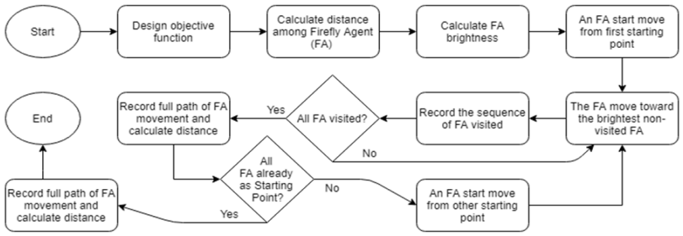
Literature survey and study
Algorithms discussed
Firefly Algorithm
Figure 1: Schematic view of Firefly algorithm [1]

Slide 6
Literature survey and study
Dataset links
http://sir.csc.ncsu.edu/portal/index.php [1]
https://docs.pytest.org/en/6.2.x [2]
https://github.com/pytest-dev/pytest-cov [2]
https://github.com/sixty-north/cosmic-ray [2]
References
[1] Muhammed Khatibsyarbini, Mohd Adham Isa, et.al, “Test case prioritisation using Firefly algorithm for Software Testing”
[2] Daniel Trübenbach, Sebastian Müller, Lars Grunske, “ A Comparative Evaluation on the Quality of Manual and Automatic Test Case Generation Techniques for Scientific Software - A Case Study of a Python Project for Material Science”
[3] Yudianto Sujana 1,2 and Hung-Yu Kao 1, (Member, IEEE) , “LiDA: Language-Independent Data Augmentation for Text Classification”
[4] Chaowei Phil Yang, Qian Liu,Zifu Wang, et.al, "COVID-Scraper: An Open-Source Toolset for Automatically Scraping and Processing Global Multi-Scale Spatiotemporal COVID-19 Records"
[5] Sudhir Kumar Patnaik, C.Narendra Babu, Mukul Bhave, "Intelligent and Adaptive Web Data Extraction System using Convolutional and Long Short-Term Memory Deep Learning Networks"

Slide 7
Queries / Challenges
Less diversity in selecting of benchmark program [1]
Incomplete data extraction [1]
Smaller test case pool [1]
No real life case study in experimental setup [1]
Low test coverage affects extensibility and maintainability, emphasizing the need for integrated testing techniques. [2]

Slide 8
Thank you

